Slide 1
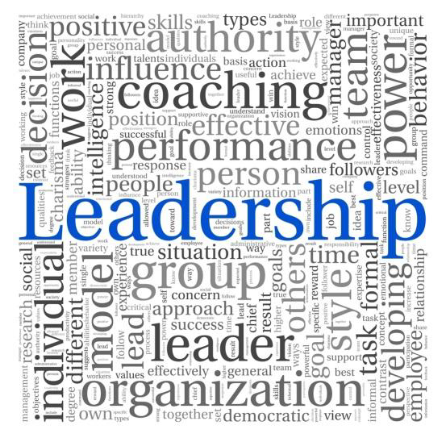
Who Are You
Your Style Makes You a Better Leader
Alan Cabelly, Ph. D., SHRM-SCP
Portland Leadership Institute
www.PortlandLeadershipInstitute.com
alanc@pdx.edu @AlanLeads 503-250-3758
September 20, 2023

Slide 2
Notes:
2

Slide 3
Today
IMPACT!

Slide 4
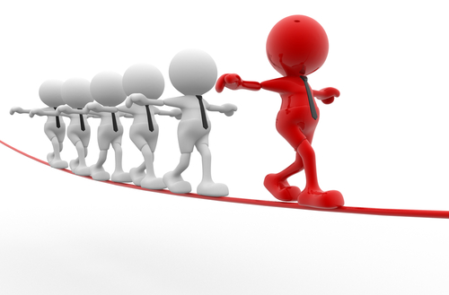
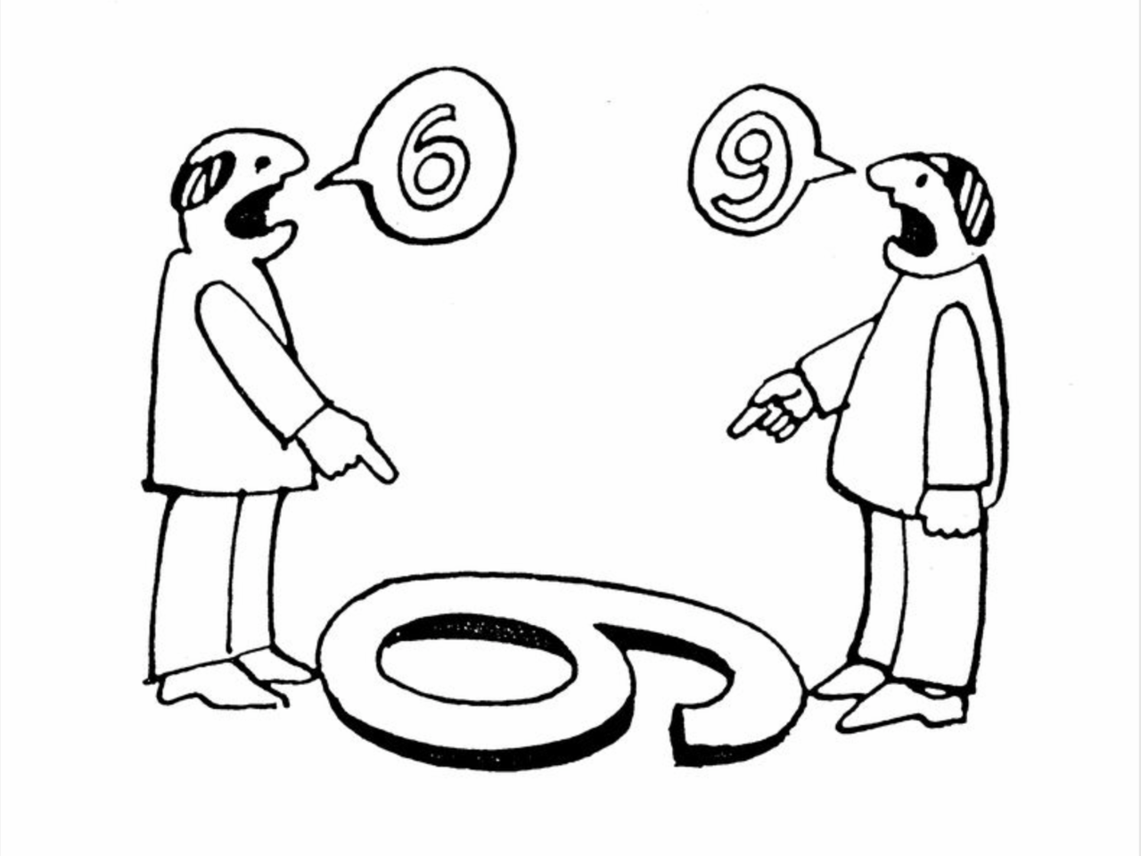
Perspective
Who’s telling the truth?

Slide 5
What Don’t You See?

Slide 6
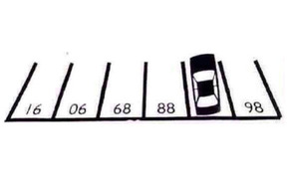
And Finally…..
What space is this car parked in?
What’s your perspective??

Slide 7
What are we looking at today?
What is Style?
Behavior vs. Personality
DiSC© Behavior Model
How do we communicate
How do we work within a team
How do you work with a... …
Talent Management
It’s all About Communicating Better to Effectively Manage and Lead Your Team
Outline

Slide 8
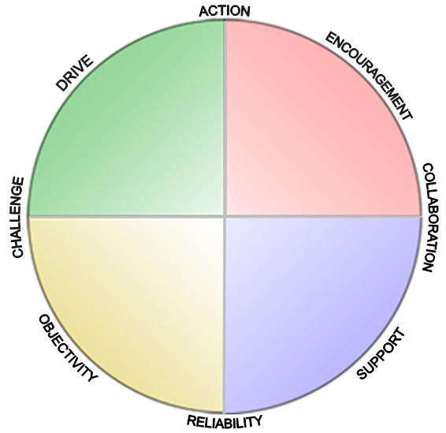
Alan Jean
Active
Fast Paced
Assertive
Enlightened
WHAT?
WHEN?
WHO?
D
DOMINANCE
i
INFLUENCE
Encourage
Logical
Objective
Skeptical
Drive
Accepting
People Focused
Empathizing
CONSCIENTIOUSNESS
C
STEADINESS
S
WHY?
HOW?
Objective
Concerned
Thoughtful
Methodical
Calm
DiSC© Intro

Slide 9
Personality vs. Behavior
Who I am vs. What I do
You’re lazy vs. You don’t seem to be working as hard as you previously have
You can’t do numbers vs. I don’t understand the budget you produced
Myers-Briggs (and many others) vs. DiSC©
So What
Leadership Matters
Personality Behavior

Slide 10
Different DiSC© assessments
DiSC© Classic
Simple Approach, affordable. Best for one introductory analysis
Everything DiSC© Catalyst
This is a suite of assessments, interactive analysis, additive assessments. Best for long term corporate work
DiSC© Workplace
DiSC© Management
DiSC© EQ
And there’s more…..
and freebies
DiSC©

Slide 12
Who Are You
What is your DiSC style?
What is DiSC style of person X?
Highest dimensions
Strength
DiSC Introduction:
Your Style

Slide 13
Discovering DiSC®
Focus on Yourself
---and---
Learn to Read People
Where are the people you work with?
Where are you?
Pick one person
DiSC Introduction:
Your Style

Slide 14
Active
Fast Paced
Assertive
What’s DiSC© ?
Are you more…?
D
DOMINANCE
i
INFLUENCE
CONSCIENTIOUSNESS
C
STEADINESS
S
Thoughtful
Methodical
Calm

Slide 15
What’s DiSC© ?
Are you more…?
D
DOMINANCE
i
INFLUENCE
Logical
Objective
Skeptical
Accepting
People Focused
Empathizing
CONSCIENTIOUSNESS
C
STEADINESS
S

Slide 16
Active
Fast Paced
Assertive
Dynamic
Bold
Demanding Doers and Fixers
Energizers and Schmoozers
PUSH PEOPLE HARD
COMPETITIVE
STRONG WILLED
i
INFLUENCE
CHEERLEADER ENTHUSIASTIC EXPRESSIVE
D
DOMINANCE
WHAT/
WHEN?
WHO?
Logical
Objective
Skeptical
Questioning
Challenging
“DRIVE”
“ENCOURAGE”
Accepting
People Focused
Empathizing
Receptive
Agreeable
CONSCIENTIOUSNESS
C
STEADINESS
S
”OBJECTIVE”
“CONCERNED”
KEEP US FOCUSED ANALYTICAL PRIVATE
WHY?
HOW?
MEDIATOR ACCOMMODATING HARMONIZING
Thoughtful
Moderate Paced
Methodical
Calm, Careful
Stabilizers and Supporters
Cautious Analyzers

Slide 17
DiSC® Styles and the Environment
Perceives Self as More Powerful than the Environment
Tries to Change, Fix, or Control Things
Tries to Persuade, Promote, or Influence Others
Perceives an Unfavorable Environment
D
i
Perceives a Favorable Environment
C
S
Tries to work within established rules, guidelines, and procedures to ensure accuracy and quality
Tries to be supportive, collaborative, and agreeable while keeping things stable
“DRIVE” “ENCOURAGE”
”OBJECTIVE” “CONCERNED”
Perceives Self as Less Powerful than the Environment

Slide 18
where WOULD you stand?
Active
Fast Paced
Assertive
What/
When?
Who?
D
DOMINANCE
i
INFLUENCE
Logical
Objective
Skeptical
Accepting
People Focused
Empathizing
CONSCIENTIOUSNESS
C
STEADINESS
S
Why?
How?
Thoughtful
Methodical
Calm
“DRIVE” “ENCOURAGE”
”OBJECTIVE” “CONCERNED”

Slide 19
Spring at LCHRMA
What would you Recommend
D
i
C
S
“DRIVE” “ENCOURAGE”
”OBJECTIVE” “CONCERNED”

Slide 20
Today at NHRMA Conf
What would you Recommend
D
i
C
S
“DRIVE” “ENCOURAGE”
”OBJECTIVE” “CONCERNED”

Slide 21
Personal Style: How to use this Info
Embrace roles: yours, and your team members’
High D, Dominance: Drive, action, speed
High i, influence: Energy and encouragement
High S, Steady: Stable, support
High C, Conscientious: Detail, accuracy, analysis
Communicate with your team, based on their individual needs
Be Enlightened
Use Personal Style Info

Slide 22
The Challenges of the Post Covid Era
How has YOUR Workplace and Workforce Changed
How do external workplace and workplace changes impact you?
What about your Management Team
Where are they on the “Resist Change/Accept Change continuum?
Impact of Millennials and Corona/Alpha Generation
and yes, the boomers are finally retiring
How can you use the knowledge you gained today to impact necessary changes in your organization
What’s Next

Slide 23
Build Your Team: Leadership Matters
Communicate WITH them, not AT them
Influence
Dominance
Meet them where they’re at
Thank you
Conscientiousness
Steadiness
Style is changeable
No style is better than any other
Be enlightened

Slide 24
Appendices

Slide 25
What do you do with a D? (think of a High D you know)
Do
Ask for ideas
Give them rope
Allow them to take the lead
Put them in the spotlight
Get aggressive on time demands
Congratulate them
Focus on the big picture
Support their team
Don’t
Micromanage them
Talk in circles
Eliminate their freedom to act
Stall
Focus on detail
Working with a D

Slide 26
What do you do with an i? (think of a High i you know)
Do
Be energetic/enthusiastic
Support their energy
Put them in the spotlight
Allow them to take charge of the situation
Celebrate accomplishments, theirs and others’
Show your feelings; ask about theirs
Don’t
Focus on detail
Focus on format/rules
Ignore fun
Isolate them
Ignore them
Take charge of their activities
Working with an i

Slide 27
What do you do with an S? (think of a High S you know)
Do
Be calm
Prepare them for change
Explain why...
Team them up with others
Thank them for their flexibility
Ask them to assist and guide others
Give them a working format
Provide security
Give them time: to think, to speak
Don’t
Surprise them
Be upset, or get them upset
Be ambiguous
Fake sincerity
Create rapid change
Push them to work alone
Ask them to work with difficult people
Stimulate conflict
Push them hard
Working with an S

Slide 28
What do you do with a C? (think of a High C you know)
Do
Be quiet and thoughtful
Warn them about impending change
Appeal to their expertise
Focus on their logic
Prepare agendas for meetings, especially difficult ones
Ask what they would like to do
Focus on the numbers
Give them time: to think, to speak
Don’t
Ignore their expertise
Say a job does not have to be perfect
Mix socializing with business
Be ambiguous
Create needless meetings
Create needless celebrations
Surprise them
Ignore the rules
Working with a C

Slide 29
How to use Personal Style Info
PORTLAND LEADERSHIP INSTITUTE
NOURISH THE LEADER WITHIN YOU d www.PortlandLeadershipInstitute.org d

Slide 30
Alan Cabelly, Ph. D., SHRM-SCP alanc@pdx.edu 503-250-3758 @AlanLeads
Portland Leadership Institute
www.PortlandLeadershipInstitute.com
Alan Cabelly, Professor Emeritus, Portland State University, is a Nationally and Internationally Recognized Speaker, Teacher, and Consultant, the recipient of numerous teaching and other HR awards. His work focuses on Leadership Excellence in the 21st Century, Generational Relationships in the Workplace, and Teambuilding with the DiSC©. His personal mission is to help individuals increase their leadership skills and improve the functioning of their work teams. Alan helps people find passion in their work life environment, leading to greater individual engagement and satisfaction, and increased organization productivity. His multigenerational family includes two grandsons and two granddaughters. In his spare time he gardens, mentors, and travels the world with his wife/partner Jean Benevento.

